Slide 1
Bayes's Formula

Slide 2
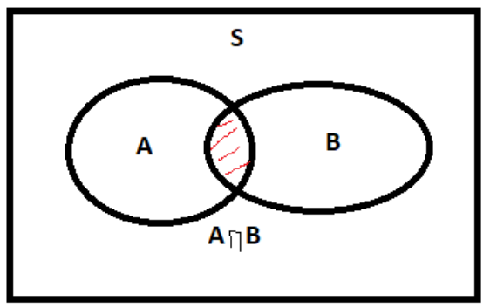
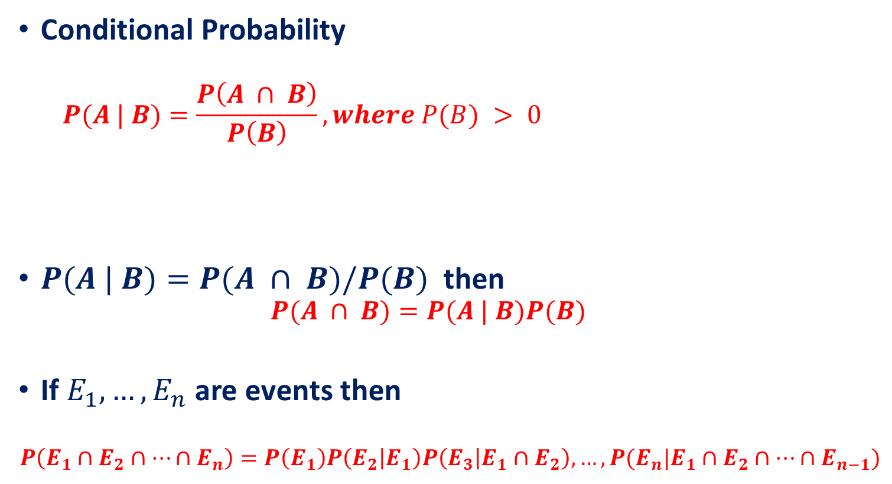
Recall
Conditional Probability
$$P(A | B)=\frac{P\left(A ∩ B\right)}{P\left(B\right)},where P(B) > 0$$
$P(A | B)=P(A ∩ B)/P(B)$then
$$P(A ∩ B)=P(A | B)P(B)$$
If $E_{1},…, E_{n}$are events then
$$P\left(E_{1}∩E_{2}∩…∩E_{n}\right)=P\left(E_{1}\right)P\left(E_{2} | E_{1}\right)P\left(E_{3} | E_{1}∩E_{2}\right),…,P(E_{n}|E_{1}∩E_{2}∩…∩E_{n−1})$$
Conditional probability of $P(A|B)$ is undefined when $P\left(B\right)=0$.
If P(B)=0, it means that the event B never occurs, so it does not make sense to talk about the probability of A given B.

Slide 3
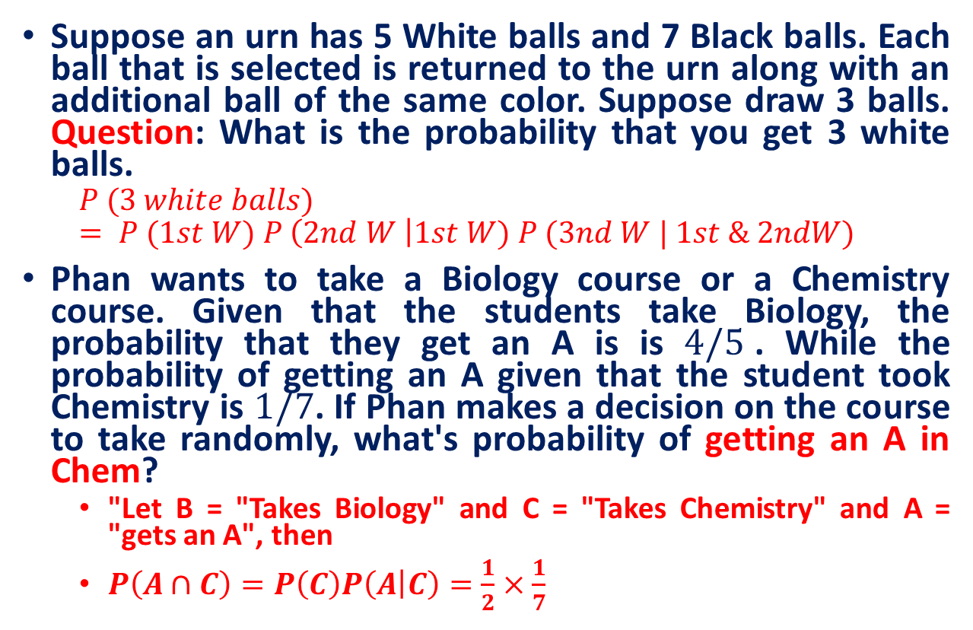
Practice Exercises
Suppose an urn has 5 White balls and 7 Black balls. Each ball that is selected is returned to the urn along with an additional ball of the same color. Suppose draw 3 balls. Question: What is the probability that you get 3 white balls.
$$P (3 white balls) = P (1st W) P \left(2nd W \right|1st W) P (3nd W | 1st \& 2ndW)$$
Phan wants to take a Biology course or a Chemistry course. Given that the students take Biology, the probability that they get an A is is $4/5$. While the probability of getting an A given that the student took Chemistry is $1/7$. If Phan makes a decision on the course to take randomly, what's probability of getting an A in Chem?
"Let B = "Takes Biology" and C = "Takes Chemistry" and A = "gets an A", then
$P\left(A∩C\right)=P\left(C\right)P\left(A | C\right)=\frac{1}{2}×\frac{1}{7}$

Slide 4
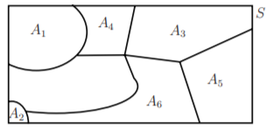

A partition of a sample space
The collection of events $A_{1}, A_{2}, . . . A_{n}$is said to partition a sample space S if
$A_{1} ∪A_{2} ∪ . . . ∪A_{n}=S$ [Exhaustive]
$A_{i} ∩A_{j}=φ$, for all $i≠j$ [non-overlapping]
$A_{i}≠φ$, for all $i$ [non-empty]

Slide 5
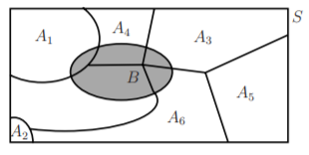
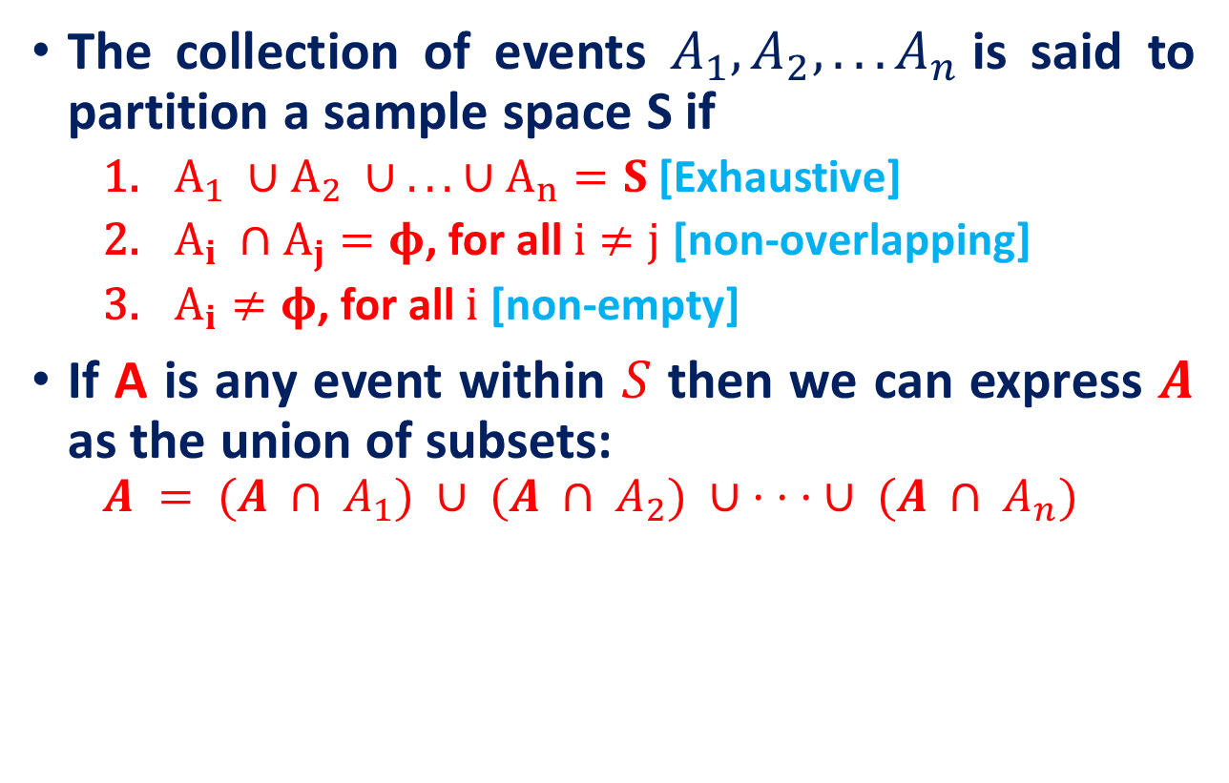
A partition of a sample space
The collection of events $A_{1}, A_{2}, . . . A_{n}$is said to partition a sample space S if
$A_{1} ∪A_{2} ∪ . . . ∪A_{n}=S$ [Exhaustive]
$A_{i} ∩A_{j}=φ$, for all $i≠j$ [non-overlapping]
$A_{i}≠φ$, for all $i$ [non-empty]
If A is any event within $S$ then we can express $A$ as the union of subsets:
$$A = (A ∩ A_{1}) ∪ (A ∩ A_{2}) ∪ · · · ∪ (A ∩ A_{n})$$
A

Slide 6
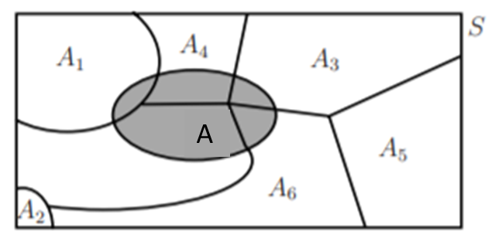
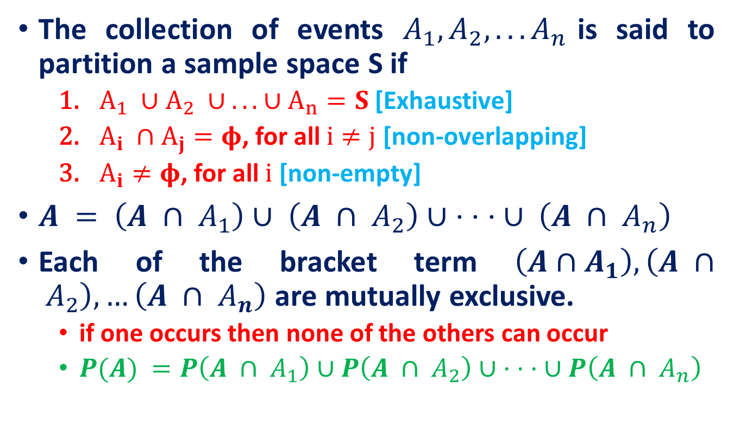
A partition of a sample space
The collection of events $A_{1}, A_{2}, . . . A_{n}$is said to partition a sample space S if
$A_{1} ∪A_{2} ∪ . . . ∪A_{n}=S$ [Exhaustive]
$A_{i} ∩A_{j}=φ$, for all $i≠j$ [non-overlapping]
$A_{i}≠φ$, for all $i$ [non-empty]
$A = \left(A ∩ A_{1}\right)∪ \left(A ∩ A_{2}\right)∪ · · · ∪ \left(A ∩ A_{n}\right)$
Each of the bracket term $\left(A∩A_{1}\right),\left(A ∩ A_{2}\right),…\left(A ∩ A_{n}\right)$ are mutually exclusive.
if one occurs then none of the others can occur
$P(A) =P\left(A ∩ A_{1}\right)∪P\left(A ∩ A_{2}\right)∪ · · · ∪P\left(A ∩ A_{n}\right)$

Slide 7
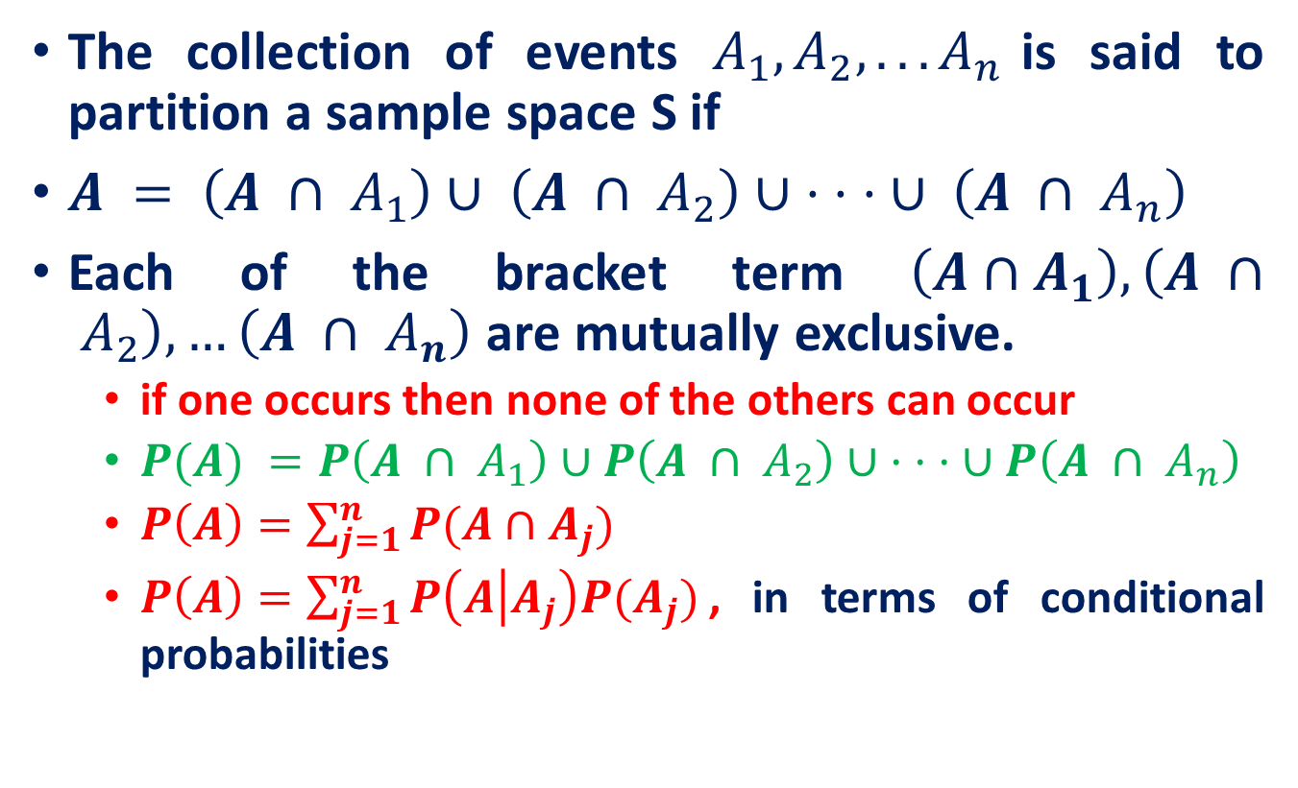
A partition of a sample space
The collection of events $A_{1}, A_{2}, . . . A_{n}$is said to partition a sample space S if
$A = \left(A ∩ A_{1}\right)∪ \left(A ∩ A_{2}\right)∪ · · · ∪ \left(A ∩ A_{n}\right)$
Each of the bracket term $\left(A∩A_{1}\right),\left(A ∩ A_{2}\right),…\left(A ∩ A_{n}\right)$ are mutually exclusive.
if one occurs then none of the others can occur
$P(A) =P\left(A ∩ A_{1}\right)∪P\left(A ∩ A_{2}\right)∪ · · · ∪P\left(A ∩ A_{n}\right)$
$P\left(A\right)=\sum_{j=1}^{n}{P(A∩A_{j})}$
$P\left(A\right)=\sum_{j=1}^{n}{P\left(A | A_{j}\right)P(A_{j})}$, in terms of conditional probabilities

Slide 8

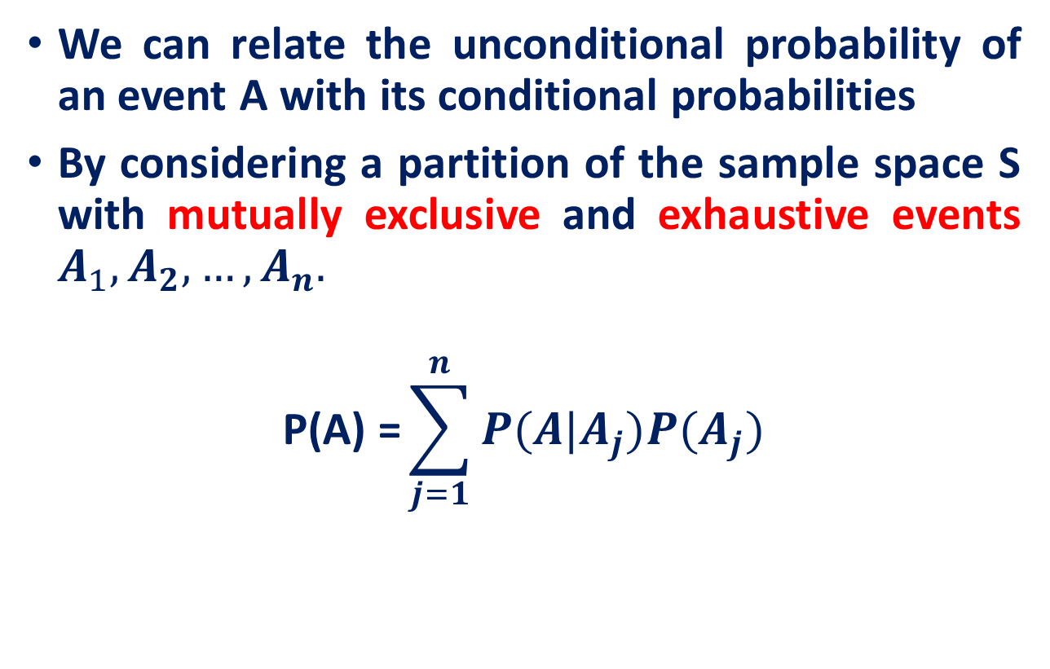


Total Probability Theorem
We can relate the unconditional probability of an event A with its conditional probabilities
By considering a partition of the sample space S with mutually exclusive and exhaustive events $A_{1},A_{2}, …,A_{n}.$
$$\text{P}\text{(}\text{A}\text{) =}\sum_{j=1}^{n}{P(A|A_{j})P(A_{j})}$$
S: Sample Space
A
A
$$A_{1}$$
A
$$A_{2}$$
$A_{1}$ and $A_{2}$ are mutually exclusive and exhaustive events
This is the theorem of Total Probability

Slide 9
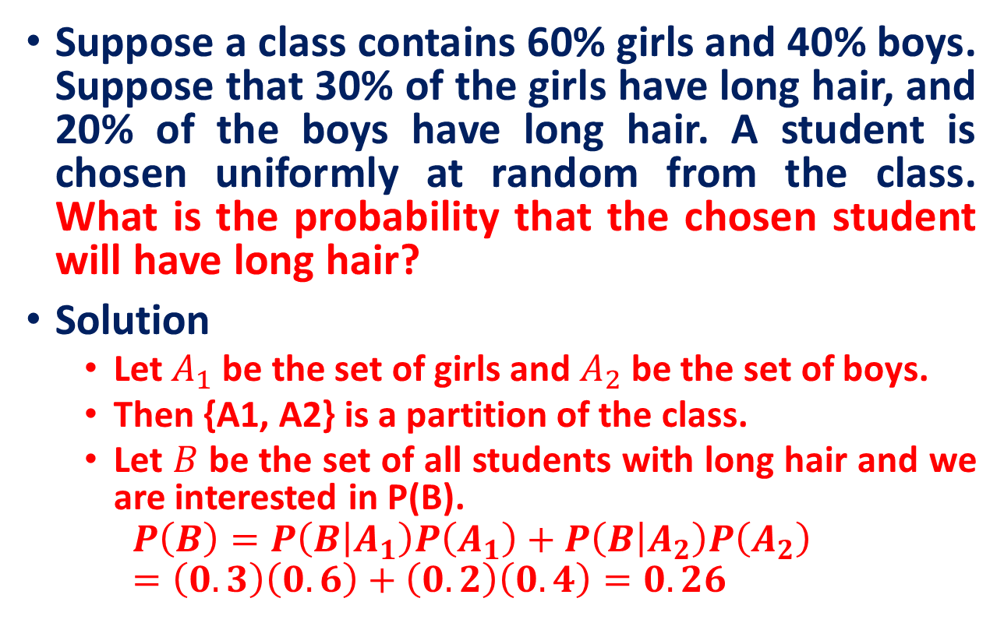
Total Probability Theorem
Suppose a class contains 60% girls and 40% boys. Suppose that 30% of the girls have long hair, and 20% of the boys have long hair. A student is chosen uniformly at random from the class. What is the probability that the chosen student will have long hair?
Solution
Let$A_{1}$be the set of girls and $A_{2}$ be the set of boys.
Then {A1, A2} is a partition of the class.
Let $B$ be the set of all students with long hair and we are interested in P(B).
$$P\left(B\right)=P\left(B | A_{1}\right)P\left(A_{1}\right)+P\left(B | A_{2}\right)P\left(A_{2}\right)=\left(0.3\right)\left(0.6\right)+\left(0.2\right)\left(0.4\right)=0.26$$

Slide 10
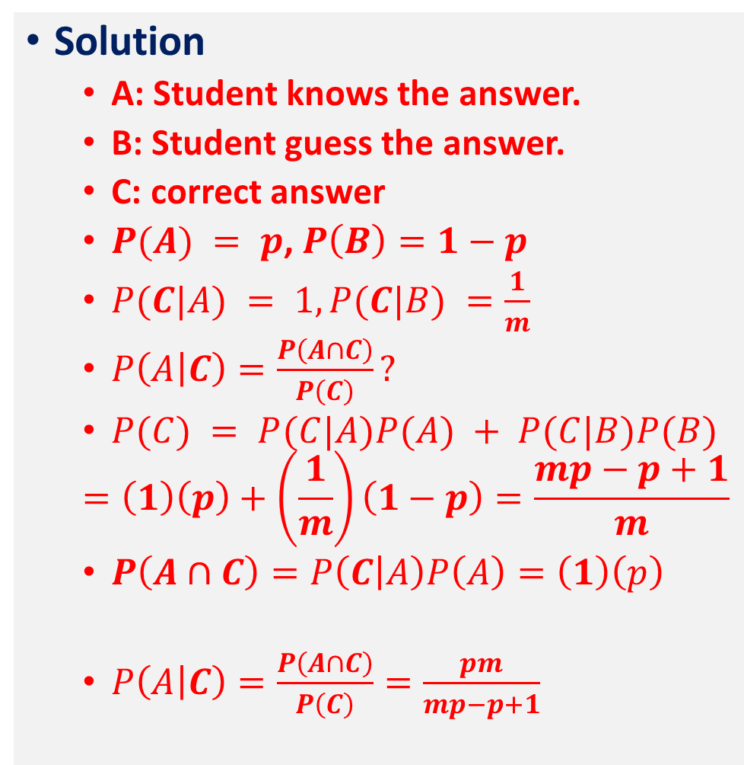
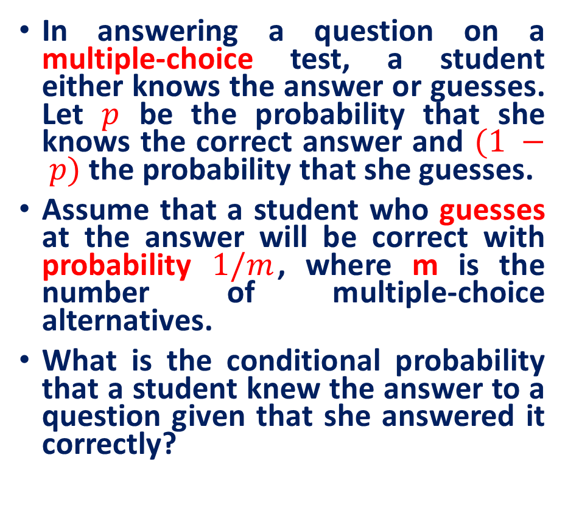
Total Probability Theorem
Solution
A: Student knows the answer.
B: Student guess the answer.
C: correct answer
$P(A) = p$, $P\left(B\right)=1−p$
$P(C|A) = 1, P(C|B) =\frac{1}{m}$
$P\left(A | C\right)=\frac{P\left(A∩C\right)}{P\left(C\right)}?$
$P(C) = P(C|A)P(A) + P(C|B)P(B)$
$$=\left(1\right)\left(p\right)+\left(\frac{1}{m}\right)\left(1−p\right)=\frac{mp−p+1}{m}$$
$P\left(A∩C\right)=P\left(C | A\right)P\left(A\right)=\left(1\right)\left(p\right)$
$P\left(A | C\right)=\frac{P\left(A∩C\right)}{P\left(C\right)}=\frac{pm}{mp−p+1}$
In answering a question on a multiple-choice test, a student either knows the answer or guesses. Let $p$ be the probability that she knows the correct answer and $(1 − p)$ the probability that she guesses.
Assume that a student who guesses at the answer will be correct with probability $1/m$, where m is the number of multiple-choice alternatives.
What is the conditional probability that a student knew the answer to a question given that she answered it correctly?

Slide 11

Bayes's Formula
$P\left(H∩D\right)= P\left(D | H\right).P(H)$, P(H)>0
$P\left(D∩H\right)= P\left(H | D\right).P(D)$, P(D)>0
So,
$$P\left(H | D\right).P\left(D\right)=P\left(D | H\right).P\left(H\right)$$
Dividing through by $P(D)$we get
$$P\left(H | D\right)=\frac{P\left(D | H\right).P\left(H\right)}{P(D)}$$
Applications of Bayes’ Theorem: Machine Learning
Naive Bayes Classifier: Find posterior probabilities of Classes
Bayesian Belief Networks : Reasoning with uncertain knowledge
Bayes’ law
This law is important in the cases where we want to know the number on the left, and we do know (or can guess) the numbers on the right.

Slide 12
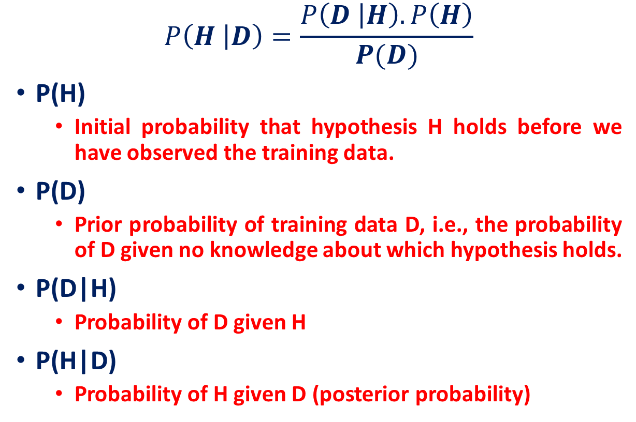
Bayes's Formula
$$P\left(H | D\right)=\frac{P\left(D | H\right).P\left(H\right)}{P(D)}$$
P(H)
Initial probability that hypothesis H holds before we have observed the training data.
P(D)
Prior probability of training data D, i.e., the probability of D given no knowledge about which hypothesis holds.
P(D|H)
Probability of D given H
P(H|D)
Probability of H given D (posterior probability)
Evaluation of posteriori probability in terms of a priori information

Slide 13
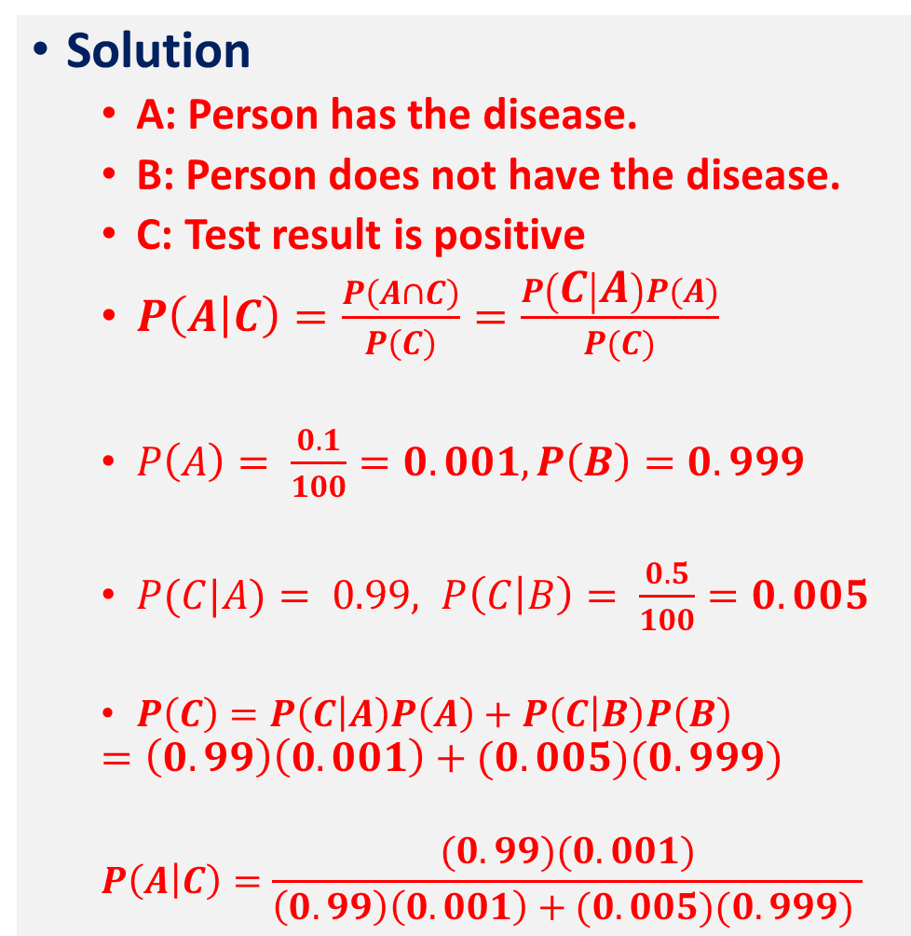
Bayes's Formula
Solution
A: Person has the disease.
B: Person does not have the disease.
C: Test result is positive
$P\left(A | C\right)=\frac{P\left(A∩C\right)}{P\left(C\right)}=\frac{P\left(C | A\right)P(A)}{P(C)}$
$P\left(A\right)= \frac{0.1}{100}=0.001, P\left(B\right)=0.999$
$P(C|A)= 0.99, P\left(C | B\right)= \frac{0.5}{100}=0.005$
$P\left(C\right)=P\left(C | A\right)P\left(A\right)+P\left(C | B\right)P\left(B\right)$
$$=\left(0.99\right)\left(0.001\right)+(0.005)(0.999)$$
$$P\left(A | C\right)=\frac{(0.99)(0.001)}{\left(0.99\right)\left(0.001\right)+(0.005)(0.999) }$$
Question
A laboratory blood test is 99 percent effective in detecting a certain disease when it is, in fact, present.
However, the test also yields a “false positive” result for 0.5% percent of the healthy persons tested.
If 0.1 percent of the population actually has the disease, what is the probability a person has the disease given that his test result is positive?

Slide 14
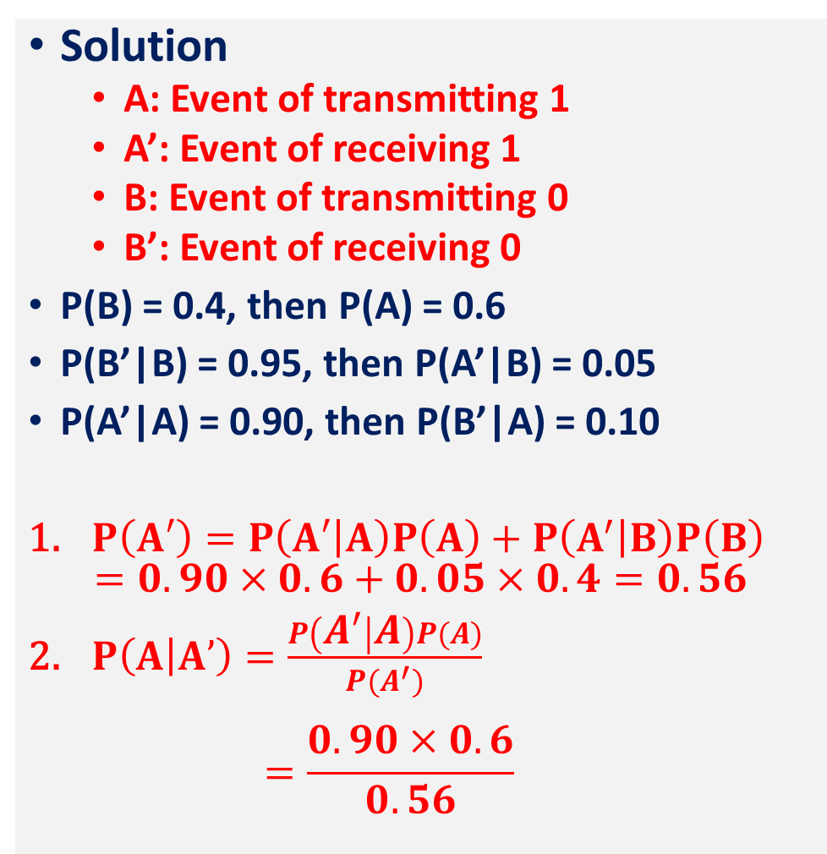
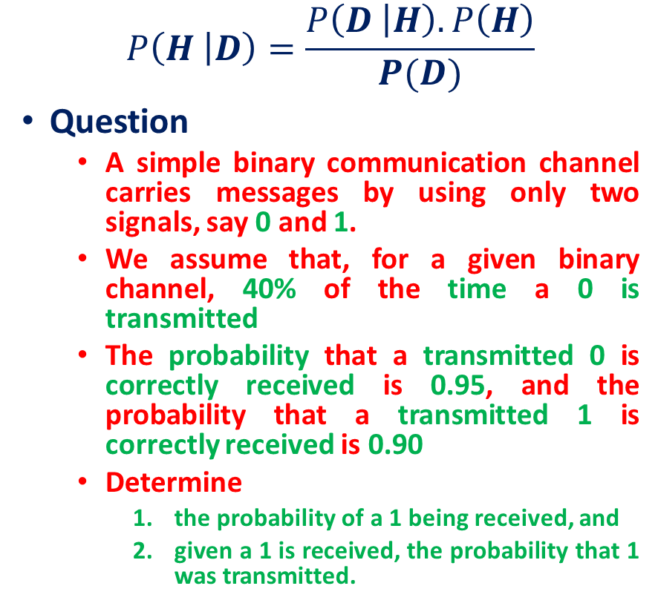
Bayes's Formula
Solution
A: Event of transmitting 1
A’: Event of receiving 1
B: Event of transmitting 0
B’: Event of receiving 0
P(B) = 0.4, then P(A) = 0.6
P(B’|B) = 0.95, then P(A’|B) = 0.05
P(A’|A) = 0.90, then P(B’|A) = 0.10
$P\left(A′\right)=P\left(A′ | A\right)P\left(A\right)+P\left(A^{′} | B\right)P\left(B\right)$ $=0.90×0.6+0.05×0.4=0.56$
$P\left(A | A’\right)=\frac{P\left(A^{′} | A\right)P(A)}{P(A^{′})}$ $=\frac{0.90×0.6}{0.56}$
$$P\left(H | D\right)=\frac{P\left(D | H\right).P\left(H\right)}{P(D)}$$
Question
A simple binary communication channel carries messages by using only two signals, say 0 and 1.
We assume that, for a given binary channel, 40% of the time a 0 is transmitted
The probability that a transmitted 0 is correctly received is 0.95, and the probability that a transmitted 1 is correctly received is 0.90
Determine
the probability of a 1 being received, and
given a 1 is received, the probability that 1 was transmitted.

Slide 15
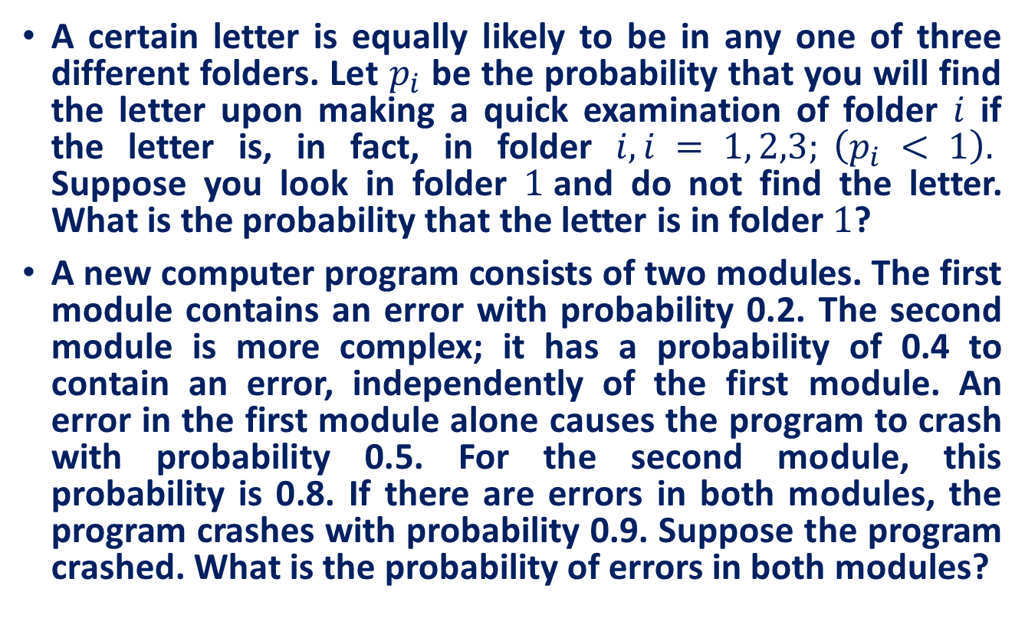
Practice Exercises
A certain letter is equally likely to be in any one of three different folders. Let $p_{i}$ be the probability that you will find the letter upon making a quick examination of folder $i$ if the letter is, in fact, in folder $i, i = 1, 2,3; \left(p_{i} < 1\right).$ Suppose you look in folder $1$and do not find the letter. What is the probability that the letter is in folder $1$?
A new computer program consists of two modules. The first module contains an error with probability 0.2. The second module is more complex; it has a probability of 0.4 to contain an error, independently of the first module. An error in the first module alone causes the program to crash with probability 0.5. For the second module, this probability is 0.8. If there are errors in both modules, the program crashes with probability 0.9. Suppose the program crashed. What is the probability of errors in both modules?

Slide 16
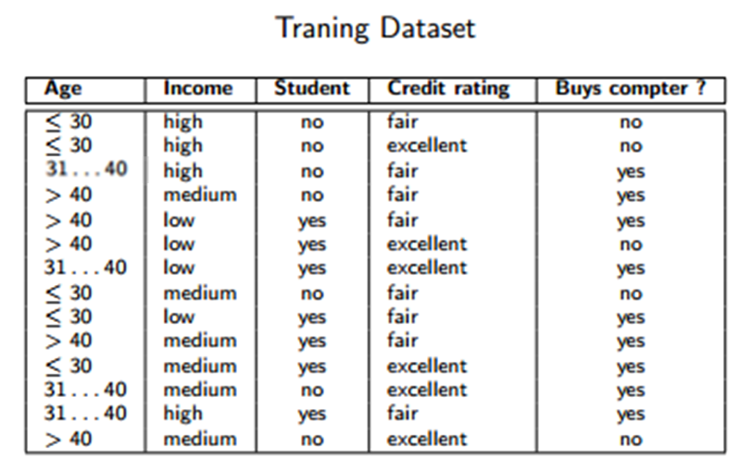
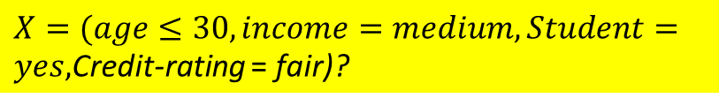
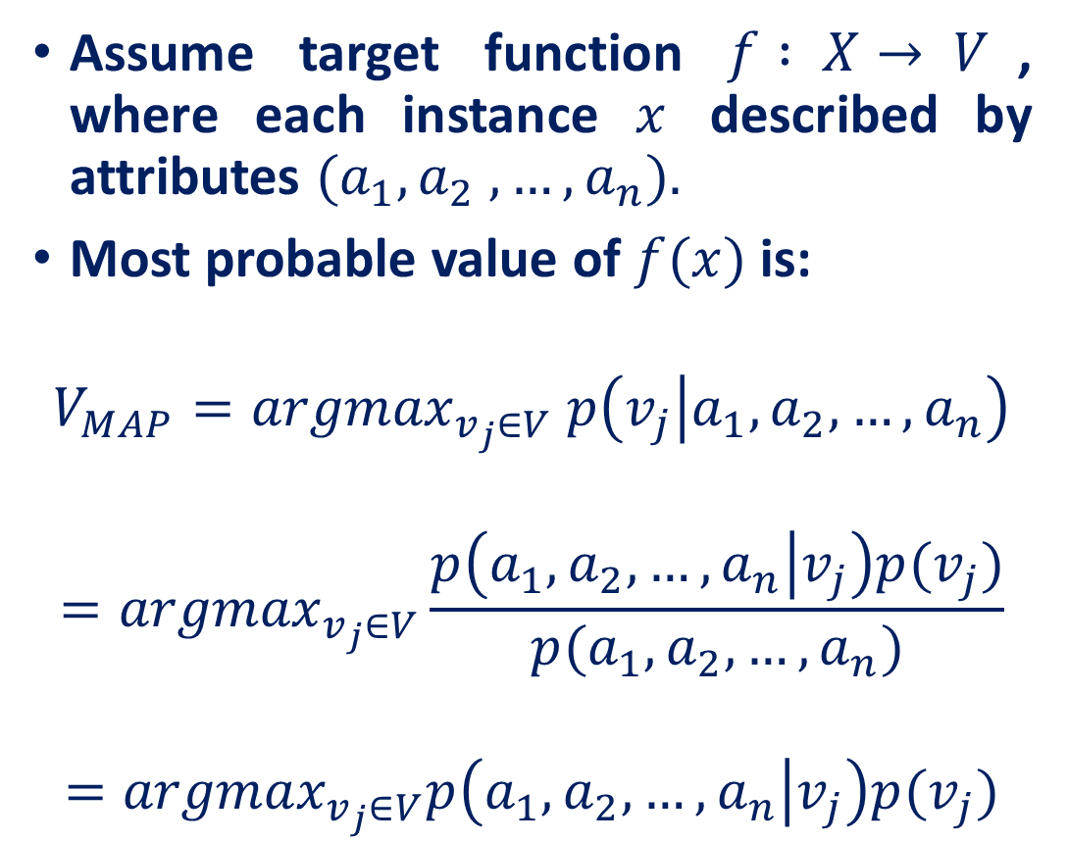

Naive Bayes Classifier
Assume target function $f : X→ V$, where each instance $x$ described by attributes $(a_{1}, a_{2} ,…, a_{n}).$
Most probable value of $f(x)$is:
$$V_{MAP}={argmax}_{v_{j}∈V} p\left(v_{j} | a_{1}, a_{2},…, a_{n}\right)$$
$$={argmax}_{v_{j}∈V}\frac{p\left(a_{1}, a_{2},…, a_{n} | v_{j}\right)p(v_{j})}{p(a_{1}, a_{2},…, a_{n})}$$
$$={argmax}_{v_{j}∈V}p\left(a_{1}, a_{2},…, a_{n} | v_{j}\right)p(v_{j})$$
$X=(age≤30, income=medium, Student=yes,$Credit-rating = fair)?
$$f : X→\{yes, no\}$$
Constant

Slide 17
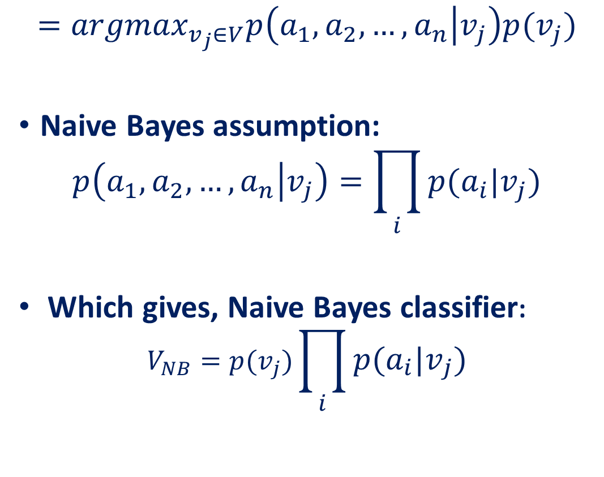
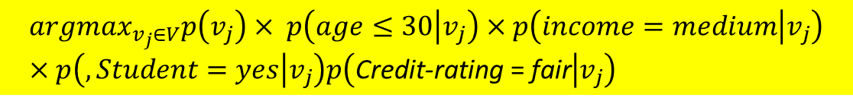
Naive Bayes Classifier
$$={argmax}_{v_{j}∈V}p\left(a_{1}, a_{2},…, a_{n} | v_{j}\right)p(v_{j})$$
Naive Bayes assumption:
$$p\left(a_{1}, a_{2},…, a_{n} | v_{j}\right)=\prod_{i}{p(a_{i}|v_{j})}$$
Which gives, Naive Bayes classifier:
$$V_{NB}=p(v_{j})\prod_{i}{p(a_{i}|v_{j})}$$
$X=(age≤30, income=medium, Student=yes,$Credit-rating = fair)?
$${argmax}_{v_{j}∈V}p\left(v_{j}\right)× p\left(age≤30 | v_{j}\right)×p\left(income=medium | v_{j}\right)×p\left(, Student=yes | v_{j}\right)p\left(\text{Credit}\text{−}\text{rating} \text{= }\text{fair} | v_{j}\right)$$

Slide 18
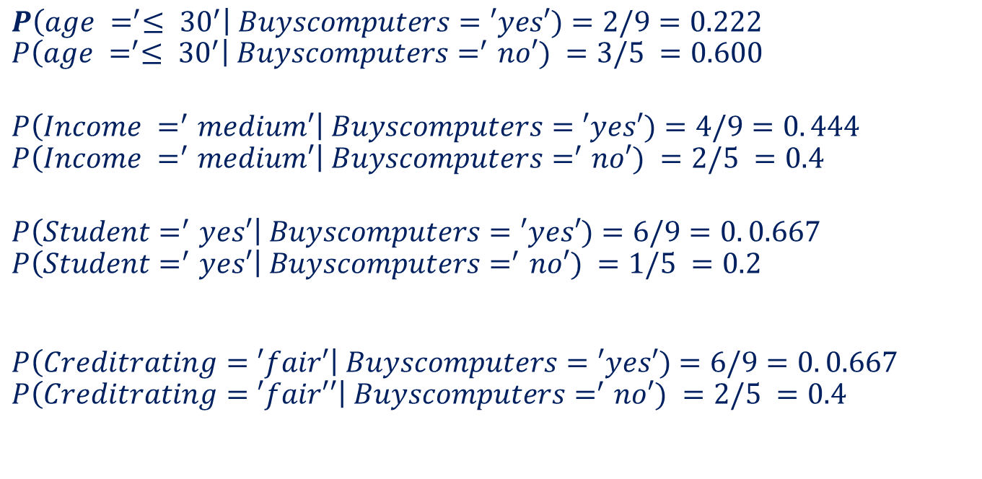

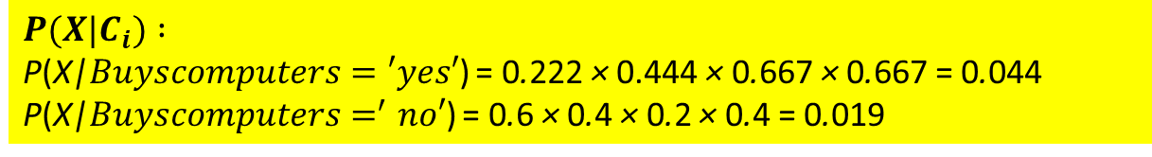
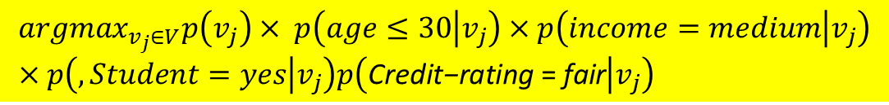
Naive Bayes Classifier
$${argmax}_{v_{j}∈V}p\left(v_{j}\right)× p\left(age≤30 | v_{j}\right)×p\left(income=medium | v_{j}\right)×p\left(, Student=yes | v_{j}\right)p\left(\text{Credit}\text{−}\text{rating} \text{= }\text{fair} | v_{j}\right)$$
$$P\left(age =^{′}≤ {30}^{′}\right| Buyscomputers=′yes′)=2/9=0.222$$
$$P\left(age =^{′}≤ {30}^{′}\right| Buyscomputers=^{′}no′) =3/5 =0.600$$
$$P\left(Income =^{′}medium′\right| Buyscomputers=′yes′)=4/9=0. 444$$
$$P\left(Income =^{′}medium′\right| Buyscomputers=^{′}no′) =2/5 =0.4$$
$$P\left(Student=^{′}yes′\right| Buyscomputers=′yes′)=6/9=0. 0.667$$
$$P\left(Student=^{′}yes′\right| Buyscomputers=^{′}no′) =1/5 =0.2$$
$$P\left(Creditrating=′fair′\right| Buyscomputers=′yes′)=6/9=0. 0.667$$
$$P\left(Creditrating=′fair′′\right| Buyscomputers=^{′}no′) =2/5 =0.4$$
X belongs to class ’buys computer = ’yes’.
$$P(X |C_{i}) × P(C_{i}) :$$ P(X|$Buyscomputers=′yes′$) × P(Buyscomputer = ‘yes’) = 0.028 (0.044 × 9/14 ) P(X|$Buyscomputers=^{′}no′$) × P(Buyscomputer = ‘no’) = 0.007 (0.019 × 5/14 )
$$P(X|C_{i}) :$$ P(X|$Buyscomputers=′yes′$) = 0.222 × 0.444 × 0.667 × 0.667 = 0.044 P(X|$Buyscomputers=^{′}no′$) = 0.6 × 0.4 × 0.2 × 0.4 = 0.019

Slide 19
Reference
Statistics with Economics and Business Applications, Chapter 3 Probability and Discrete Probability Distributions
Modern Business Statistics, Slides by John Loucks
lecture notes on Probability Theory by Phanuel Mariano

